Slide 1
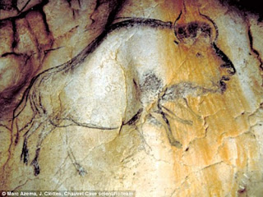
Long after our ancestors could properly communicate through speech about 100,000 years ago, they found ways of visually preserving memory and history. Dating back as far as 40,000 years ago, cavemen would create paintings (mostly of animals) on their cave’s walls which we now refer to as “pictographs”.

Slide 2
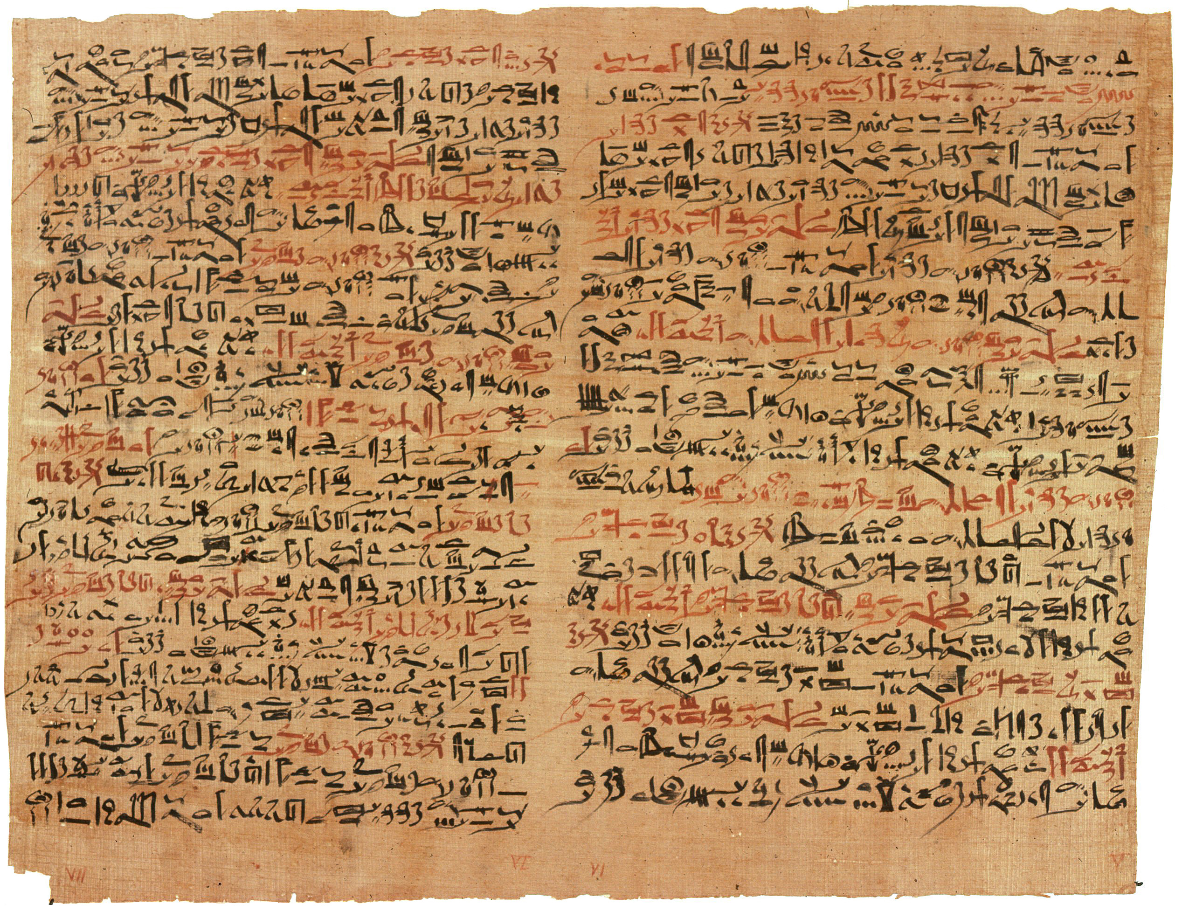
When the Egyptians could use papyrus to record history, they began to use it as posters to hang on walls in which they carved notices.
The Greeks would have town criers shouting out the approach of ships.
In Rome, items that stores sold were often engraved on walls to draw the attention of passersby.

Slide 3
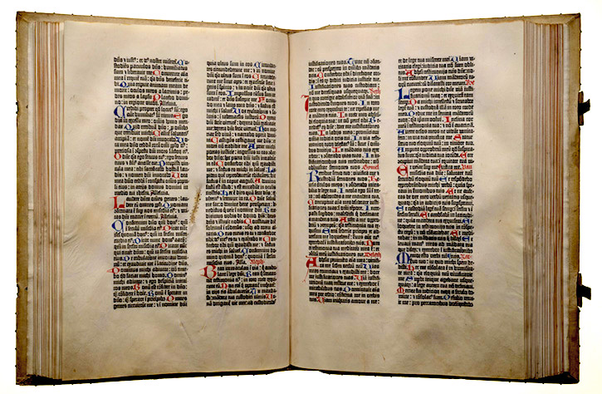
Jump ahead to the creation of text that can be duplicated and spread around. Johanne Gutenberg. around the year 1440, created the first printing press by arranging letters, covering them in ink, and pressing them onto paper.

Slide 4
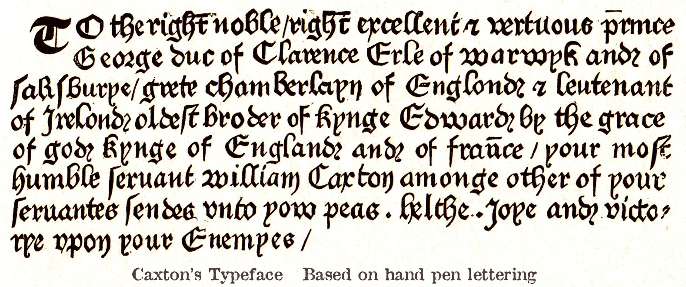
In 1472 when William Caxton, created the first printed English advertisement with a poster tacked on church doors announcing new book’s sale.

Slide 5



This paved the way for a form of mass media known as mass (one-to-many) communication, represented by the newspaper, the television, and the internet.

Slide 6
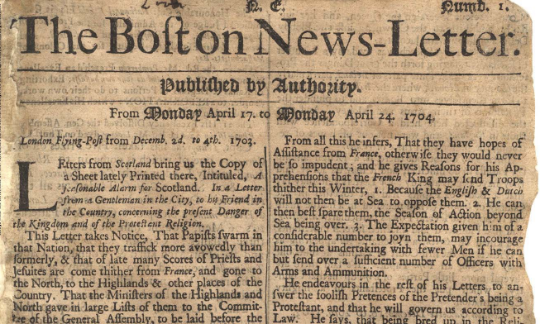
In 1704 the Boston Newsletter, created what is said to be the world’s first newspaper ad which announced real estate on Long Island, lost anvils, and stolen goods being recovered.

Slide 7
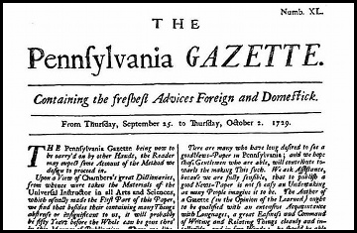
One of the Founding Fathers of America, Benjamin Franklin would even contribute to the growth of the art of selling in America by buying the Philadelphia Gazette and turning it into the very first mass communication vehicle that was backed by advertising. Papers were very cheap for readers because advertisers covered the production of the papers. Because the papers were so popular, more and more people became aware of the products of the advertisers.

Slide 8
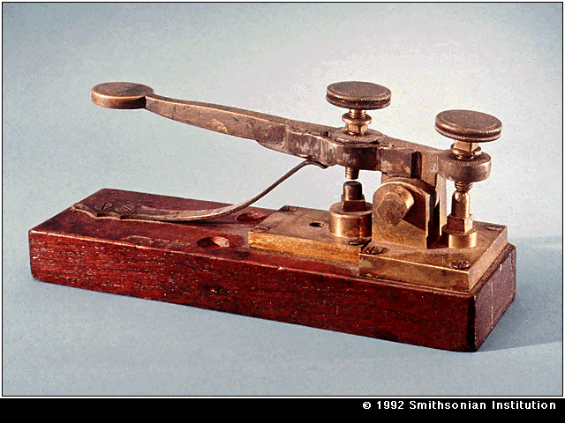
In 1840. One-to-one communication transcended its traditional form, sending and receiving letters. Samuel Morse created the first means of communication over long distance. The means being the telegraph which used a unique alphabet, consisting of dashes and dots. Alexander Graham Bell improved upon this with the telephone, where two people can hear each other’s voices as they spoke, making translation unnecessary, unlike the telegraph.

Slide 9
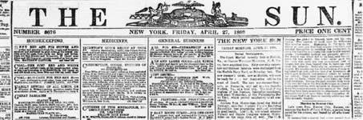
Meanwhile, Gutenberg’s printing machine would reach its peak at the creation of the New York Sun, the world’s first daily newspaper. Mass media through sound would have to wait for the next century when Guglielmo Marconi created wireless radio. During the Great Depression, radio would become the number one source of entertainment thanks to music, dramatic radio plays, and comedies. Then television took over that position after World War II with its viewers smoothly transitioning from hearing stories from a box to seeing them in a box.

Slide 10
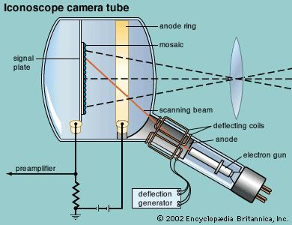
After Paul Nipkow created a television system that required mechanical scanning in 1884, Vladimir K Zworykin made the first electronic television scanning system thanks to his invention, the iconoscope which converted light into electrical energy in 1923. But he was not the first to take on this endeavor as Philo T. Farnsworth, one year before, designed his own electronic television system. This rivalry caused Zworykin to join forces with RCA, which had already licensed Farnsworth's patents, and RCA’s General Electric, and Westinghouse to create a television station based in New York City called W2XF in 1936.

Slide 11
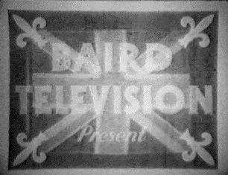
Meanwhile in England, there was another innovator in television named John Logie Baird. A Scotsman who was just as ambitious as Farnsworth and Zworykin, Baird demonstrated his own system for the sending of live television images which was demonstrated before 50 scientists in a small attic in London in 1926. One year later, his system was demonstrated over 438 miles of telephone wire and the Baird Television Development company was created. The year after that, the company sent the first transatlantic television transmission which was from London to New York City.

Slide 12
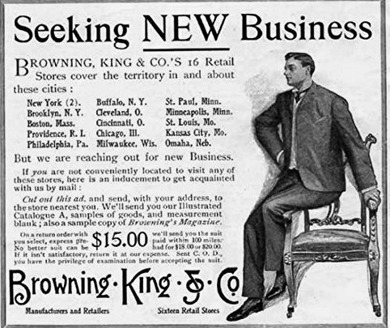
AT&T/Belle set up its own New York City based radio station, WEAF in 1922, and on August 22nd of that year, they aired the first radio commercial, which was for real estate. The next year, the Browning King clothes company bought time on that channel to sponsor the Browning King Orchestra.

Slide 13
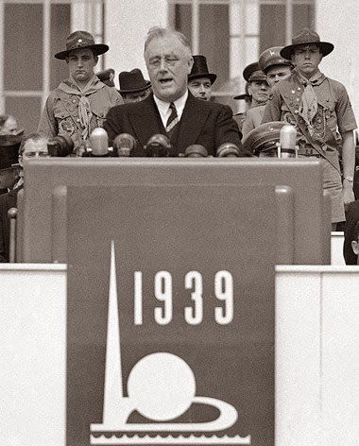
In 1939, television made its first public appearance in America, thanks to radio pioneer, David Sarnoff, in the form of an address to the nation by President Franklin D. Roosevelt. However it would take years for this revolution to take off due to America’s involvement in World War II. It was not until after the war when the economy was booming, the number of options for television programming increased, and the prices for sets went down that the demand for television was at full swing.

Slide 14
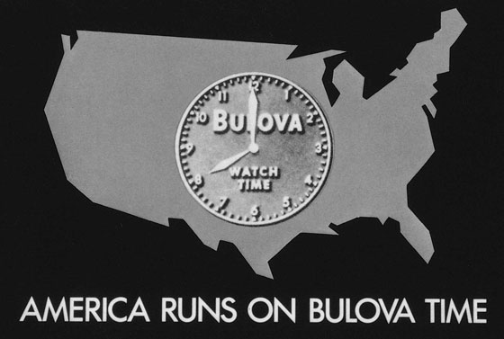
The Bulova watch company aired the very first ad to appear on TV in 1941. After that, live advertisements boomed. Throughout the 1950s’ there were programs like The Colgate-Palmolive Comedy Hour and The Dinah Shore-Chevy Show. Since then, commercials have become shorter and known as “spots”.

Slide 15
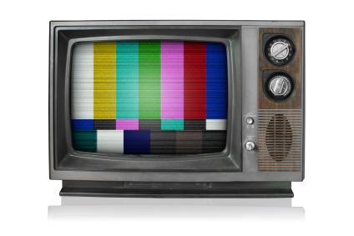
The next step was color TV which was already demonstrated by John Logie Baird in 1928. During the 1950’s, there was a rivalry between CBS and RCA to bring color television to the public. While the former achieved this by mechanical means, the latter used electronic ways. Color television, like black-and-white television, would also take a long time to develop in popularity due to their price and the fact that nearly every TV camera was only capable of black-and-white photography.

Slide 16
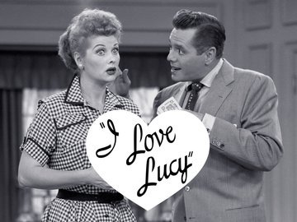
In the 1950’s television really began to dominate the average American’s way of life, thanks to programs like I Love Lucy, Studio One, and Kraft Theater. It became quite clear that people were looking less towards simple sounds in their living rooms via radio and more to sounds accompanied by images.

Slide 17

In the 1960’s, four scientists and engineers, Leonard Kleinrock, Paul Baran, Donald Davies, and Lawrence Roberts with the Defense Advanced Research Projects Agency providing funding united to form a true technological innovation: the Advanced Projects Research Agency Network. This networks used trailblazing packet-switching technology to connect four separate universities through their computers. APRANET was officially launched in 1969, thus bringing forth the way for the idea of computers being united over as far as a mile’s distance.

Slide 18
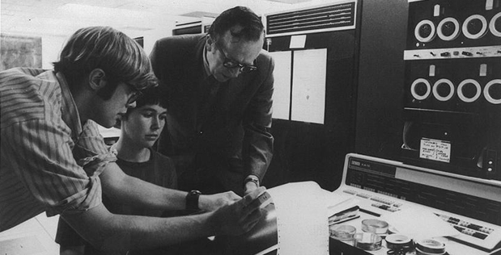
APARNET would soon gain computer attachments left and right. Robert Kahn, who created the Information Processing Techniques Office for APRANET, revealed the system to the public by connecting 20 separate computers at the International Computer Communication Conference in 1972. After this amazing revelation, other people in the computer industry would become instantly fascinated and wanted a part of it.

Slide 19
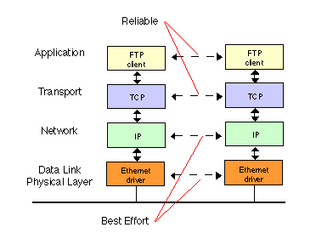
However, there was still no international APARNET. That was where manager, Vincent Cerf and Kahn would have to come in. The two created the Transmission Control Protocol and Internet Protocol in 1978 which together would succeed in connecting computers on a global scale. The former digests a message into individual packets and the latter makes sure the destination of that message receives it.

Slide 20
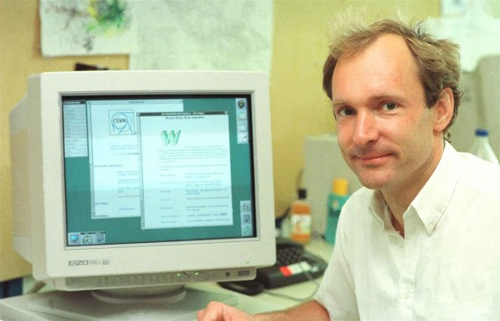
The World Wide Web was officially born in 1991 with the dawn of the first website, http://info.cern.ch/created by Tim-Burners Lee of the European Laboratory of Particle Physics (CERN) which was made to explain the concept of the WWW which was to use the internet to display and share information among the internet. By the end of 1992, 26 websites were created and the first internet browser, MOSAIC was created and on April 30th 1993, CERN officially declared that WWW would be available to people all over the world. The rest is history.

Slide 21
Advertising Through the Ages. (n.d.). Retrieved November 28, 2015, from http://cambridgemuseum.org.nz/Articles/advertart.htm
Agencies, T. (2014, October 9). World's oldest cave paintings from 40,000 years ago discovered in Indonesia. Retrieved October 8, 2015, from http://www.telegraph.co.uk/news/worldnews/asia/indonesia/11150560/Worlds-oldest-cave-paintings-from-40000-years-ago-discovered-in-Indonesia.html
"Ancient Scripts: Sumerian." Ancient Scripts: Sumerian. Ancient Scripts: Sumerian. Web. 10 Oct. 2015. <http://www.ancientscripts.com/sumerian.html>.
Covey, L. (2005, June 22). Franklin and Advertising. Retrieved November 26 2015, from http://commbasics.typepad.com/my_weblog/2005/06/franklin_and_ad.html
Internet Hall of Fame. (n.d.). Retrieved October 10, 2015, from http://www.internethalloffame.org/internet-history/timeline
John Logie Baird (1888 - 1946). (n.d.). Retrieved October 10, 2015, from http://www.bbc.co.uk/history/historic_figures/baird_logie.shtml
Kain, E. (2013, May 27). The Five Biggest Problems with the X Box One. Forbes. Retrieved November 27th 2015. from http://www.forbes.com/sites/erikkain/2013/05/27/the-five-biggest-problems-with-the-xbox-one/
Lynch, J. (2015, June 9). Why TV Is Still the Most Effective Advertising Medium Key findings from MarketShare study. Retrieved November 26, 2015. from http://www.adweek.com/news/advertising-branding/why-tv-still-most-effective-advertising-medium-165247
Mcdowall, M. (2015, February 9). How a simple 'hello' became the first message sent via the Internet. Retrieved October 9, 2015, from http://www.pbs.org/newshour/updates/internet-got-started-simple-hello/
Medoff, Norman J., and Barbara K. Kaye. "Tuning in to Electronic Media." Electronic Media Then, Now, and Later. 2nd ed. Burlington, MA: Focal, 2011. 4-6. Print.
Medoff, Norman J., and Barbara K. Kaye. "Television." Electronic Media Then, Now, and Later. 2nd ed. Burlington, MA: Focal, 2011. 37-39. Print.
Medoff, Norman J., and Barbara K. Kaye. "Television." Electronic Media Then, Now, and Later. 2nd ed. Burlington, MA: Focal, 2011. 44. Print.
Medoff, N., & Kaye, B. (2011). Advertising. In Electronic Media Then, Now, and Later (2nd ed., pp. 131-135). Burlington: Focal, 2011. 131-135. Print.
Medoff, N., & Kaye, B. (2011). Regulation, LEgal Issues and Ethics. In Electronic Media Then, Now, and Later (2nd ed., pp. 231-232). Burlington: Focal, 2011. Print.
Medoff, N., & Kaye, B. (2011). Regulation, Legal Issues and Ethics. In Electronic Media Then, Now, and Later (2nd ed., pp. 236-237). Burlington: Focal, 2011. Print.
Medoff, N., & Kaye, B. (2011). Regulation, Legal Issues and Ethics. In Electronic Media Then, Now, and Later (2nd ed., pp. 240-241). Burlington: Focal, 2011. Print.
Medoff, N., & Kaye, B. (2011). Regulation, Legal Issues and Ethics. In Electronic Media Then, Now, and Later (2nd ed., pp. 245-246). Burlington: Focal, 2011. Print.
Medoff, N., & Kaye, B. (2011). Regulation, Legal Issues and Ethics. In Electronic Media Then, Now, and Later (2nd ed., pp. 247-249). Burlington: Focal, 2011. Print.
McClung Museum. (n.d.). Retrieved October 8, 2015, from http://mcclungmuseum.utk.edu/papyrus/
Peter, I. (n.d.). History of the world wide web. Retrieved October 8, 2015, from http://www.nethistory.info/History of the Internet/web.html
Rouse, M. (2008, October 1). What is TCP/IP (Transmission Control Protocol/Internet Protocol)? - Definition from WhatIs.com. Retrieved October 10, 2015, from http://searchnetworking.techtarget.com/definition/TCP-IP
The Gutenberg Bible. (n.d.). Retrieved October 8, 2015, from http://www.hrc.utexas.edu/exhibitions/permanent/gutenbergbible/
Tim Berners-Lee. (n.d.). Retrieved October 9, 2015, from https://www.w3.org/People/Berners-Lee/
What is TCP/IP (Transmission Control Protocol/Internet Protocol)? - Definition from WhatIs.com. (2008, October 1). Retrieved October 8, 2015, from http://searchnetworking.techtarget.com/definition/TCP-IP

